Slide 1
ODK: From Tablet to Server
Dr. Caroline Krafft
St. Catherine University
cgkrafft@stkate.edu
Version: January 14, 2018

Slide 2
Pushing from tablet to server
Usually tablets get the files by syncing with the server
Server→Tablet
However, to put a new (version) of the survey on the server, the administrator pushes from the tablet to the server
Tablet→server

Slide 3
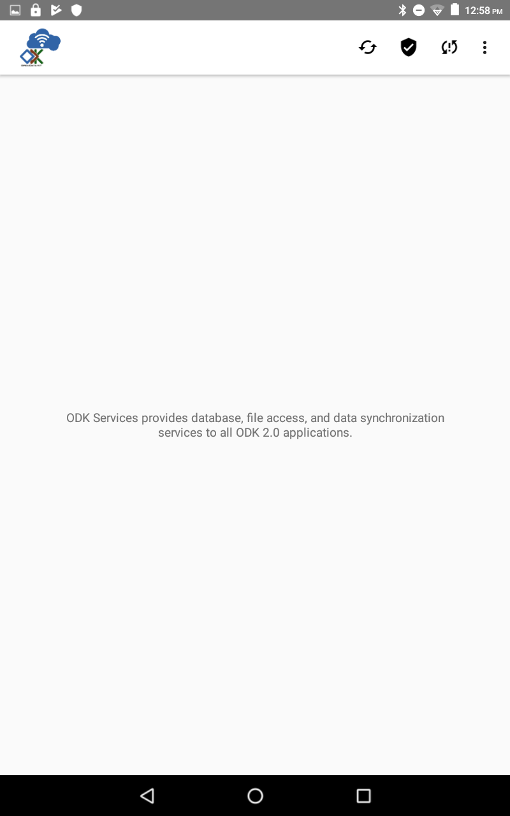
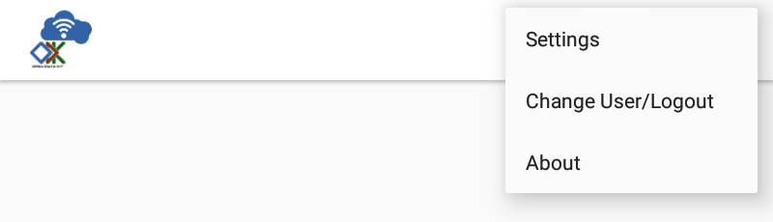
Preparing the tablet
Open ODK Services -- ODK Services manages sync
Click the icon with three vertical dots in the top right corner
Then click Settings

Slide 4
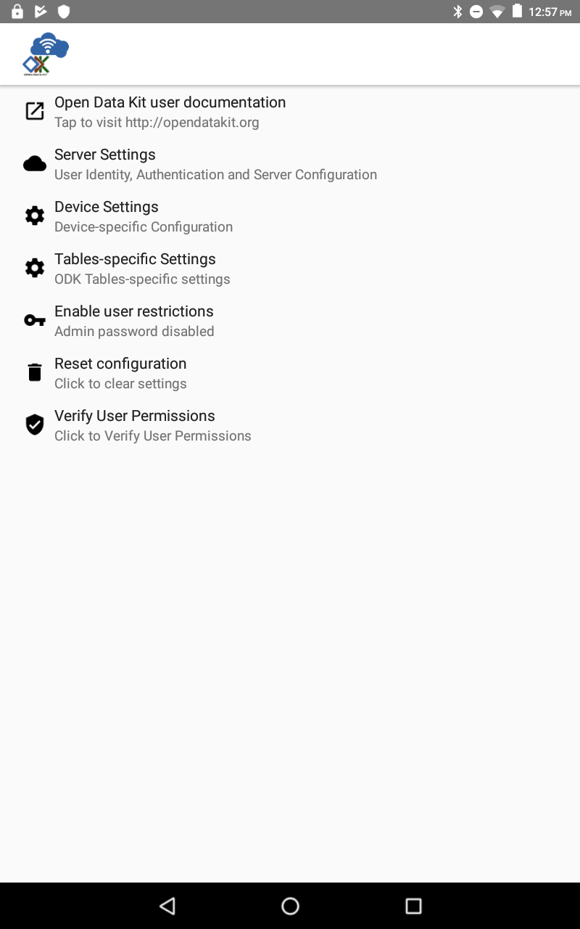
Set up Server Settings
Make sure that your server settings are correct
You will need:
Server URL
Username
**Change Server
sign on credential
to Username
Server password

Slide 5
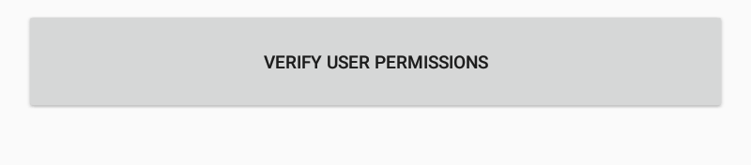
Verify User Permissions
Click Verify User
Permissions
Then you will get another
button that says
Verify User Permissions
Success message: Success! User permissions have been updated.

Slide 6
Resetting App Server
In ODK services press the sync (two arrow) button
Select Reset App Server
This will change what is on the server—ONLY THE ADMINISTRATOR SHOULD DO THIS TO SET UP
Make sure no one else has credentials to do this
WARNING: If a data table on the server does not exist on the device, that table, all of its data, and all associated files (e.g., forms) will be deleted from the server.
Confirm (click reset)
Should get a success message

Slide 7
Syncing After you have collected Data

Slide 8
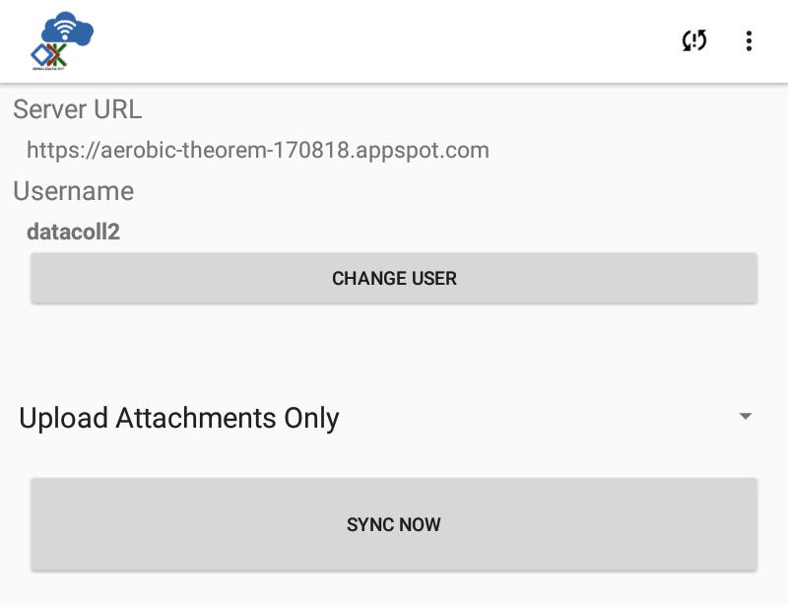
Syncing data to the server
After verifying user permissions, you can sync data.
First, click the two arrow buttons.
Then, click Sync Now

Slide 9
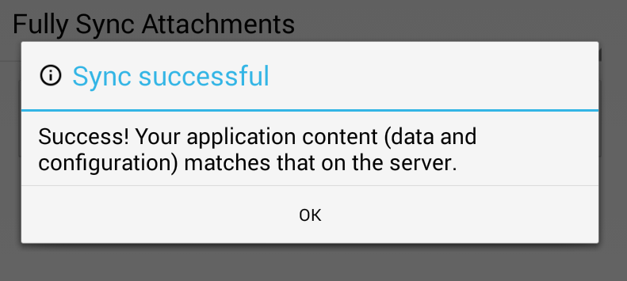
After syncing
After syncing, jumped out to main screen of ODK services. If click sync button again, should see:

Slide 10
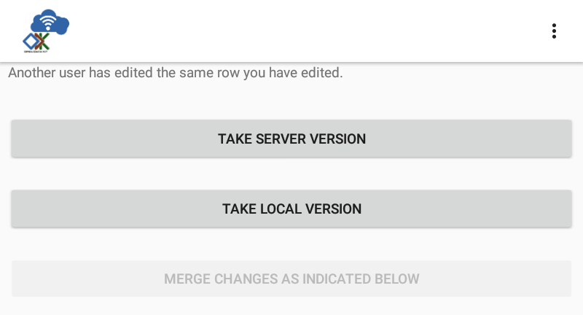
Conflicts when Syncing Data
After you sync your data always check ODK Tables.
If there is a conflict between the data you have and what’s on the server, ODK tables will give you two options:

Slide 11
Check it out on Aggregate
Now you log in to the server and see our new data
Go to ODK tables tab in aggregate and view table
Should see a table for your current table_id

